Slide 1

Partner
Logo
Customer
Logo
Welcome!
Microsoft Teamwork Transformation workshop for [Client Name]
Speaker Name
Date

Slide 2
THIS INFORMATION IS FOR YOUR PERSONAL USE ONLY. NEITHER THE AUTHOR OR PRESENTER MAKES ANY REPRESENTATION EXPRESS OR IMPLIED AS TO THE CONTENT OF THIS INFORMATION.

Slide 3
Introductions
30 minutes
Notes:
Introduce yourself and other facilitators—talk about your background, your work with SharePoint and Microsoft Teams, and your role for this workshop
Ask participants to introduce themselves and their roles
Discuss what you want to get out of the workshop

Slide 4
Workshop overview
Day 1
Day 2
Results
Business Plan Development
Review Microsoft 365 Modern Workplace Art of the Possible
Identify relevant scenario(s)
Review modern workplace opportunities
Identify target transformation pilot site
Transformation Plan Development
Create transformation wave strategy
Create adoption plan
Transformation business plan
Pilot, roadmap, and adoption plan

Slide 5
Day 1 agenda
9:00 – 9:30 |  | Introductions
9:30 – 10:00 |  | Art of the Possible review
10:00 – 11:00 |  | Scenario ideation
11:00 – 11:15 |  | Break
11:15 – 12:15 |  | Assessment review
12:15 – 1:00 |  | Lunch break
1:00 – 2:00 |  | Site transformation approach
2:00 – 2:30 |  | Additional considerations

Slide 6
Day 1 key outcomes
Ensure participants are grounded in what’s possible with modern workplace collaboration
Develop current state understanding of existing SharePoint environment
Identify target transformation pilot site

Slide 7
Art of the possible
30 minutes

Slide 8

Microsoft 365
Fostering a new culture of work
Unlocks creativity
Built for teamwork
Integrated for simplicity
Intelligent security
Notes:
Microsoft 365 Enterprise delivers on 4 key promises:
Unlocks creativity by enabling people to work naturally with ink, voice and touch, all backed by tools that utilize AI and machine learning.
Provides the broadest and deepest set of apps and services with a universal toolkit for teamwork, giving people flexibility and choice in how they connect, share and communicate.
Simplifies IT by unifying management across users, devices, apps and services.
Helps safeguard customer data, company data and intellectual property with built-in, intelligent security.
Let us look deeper into each of these promises.
We are living in a time of inflection. Digital transformation is the biggest change any of us has seen in our lifetime.
Companies invest in technology to optimize operations, transform products, engage customers, and empower employees.
The challenge for us and for our customers will be about finding the way to empower people to do their best work. This starts with fostering a culture of work that is inspiring for everyone.
The challenge for us and for our customers will be about finding the way to empower people to do their best work. This starts with fostering a culture of work and embracing the trends in the workplace that make work inspiring for everyone.
And we know there is tremendous opportunity for business growth and innovation from doing so.
But today, our solutions are not best-equipped to address these changing needs.
Customers are telling us that we need to do more – that our solutions are still too complex.
To deliver on this, we are simplifying customer experience by bringing together Office 365, Windows 10 and EMS - with introduction of Microsoft 365
So, what is Microsoft 365? It’s a complete, intelligent solution that empowers everyone to be creative and work together, securely.
It includes Office 365, Windows 10 and Enterprise Mobility + Security
For the enterprise customers, Microsoft 365 Enterprise is built on the foundation of Secure Productive Enterprise

Slide 9


Microsoft 365
A complete, intelligent solution that empowers everyone
Office 365 · Windows 10 · Enterprise Mobility + Security
Unlocks creativity
Built for teamwork
Integrated for simplicity
Intelligent security

Slide 10


We use Microsoft 365 Enterprise to foster a modern and highly secure workspace for employees empowered by teamwork and collaboration—everything we need to succeed in a global, digital market.
Bobby Berry Senior Vice President, Business Solutions
Notes:
We have great customer momentum with customers already realizing value with Microsoft 365 Enterprise.
Optional: Reiterate key areas of Microsoft 365 Enterprise:
To support the new culture of work, it’s critical that we give employees tools that make them more productive, but perhaps more importantly is helping them be more creative. Be more creative in crafting a business plan or a designing sales report. Be more creative in creating a pitch deck for a big customer meeting or even designing the next skyscraper.
Microsoft 365 provides tools that help people be more creative thru natural user interfaces and by infusing intelligence and machine learning into the apps that people use every day, like Microsoft Office.

Slide 11



better together
Notes:
SharePoint ♥s Teams [blog + ‘how to’ demo video]: "4 topnotch teamwork tips for Microsoft Teams plus SharePoint" [9/24/19]: https://techcommunity.microsoft.com/t5/Microsoft-SharePoint-Blog/4-topnotch-teamwork-tips-for-Microsoft-Teams-plus-SharePoint/ba-p/864155

Slide 12

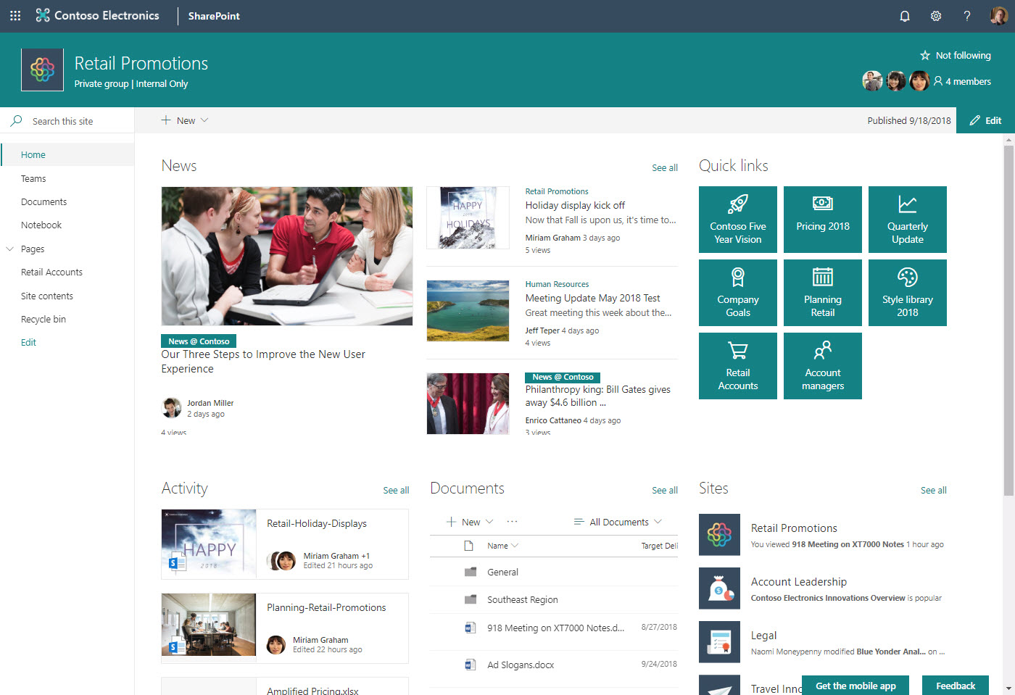
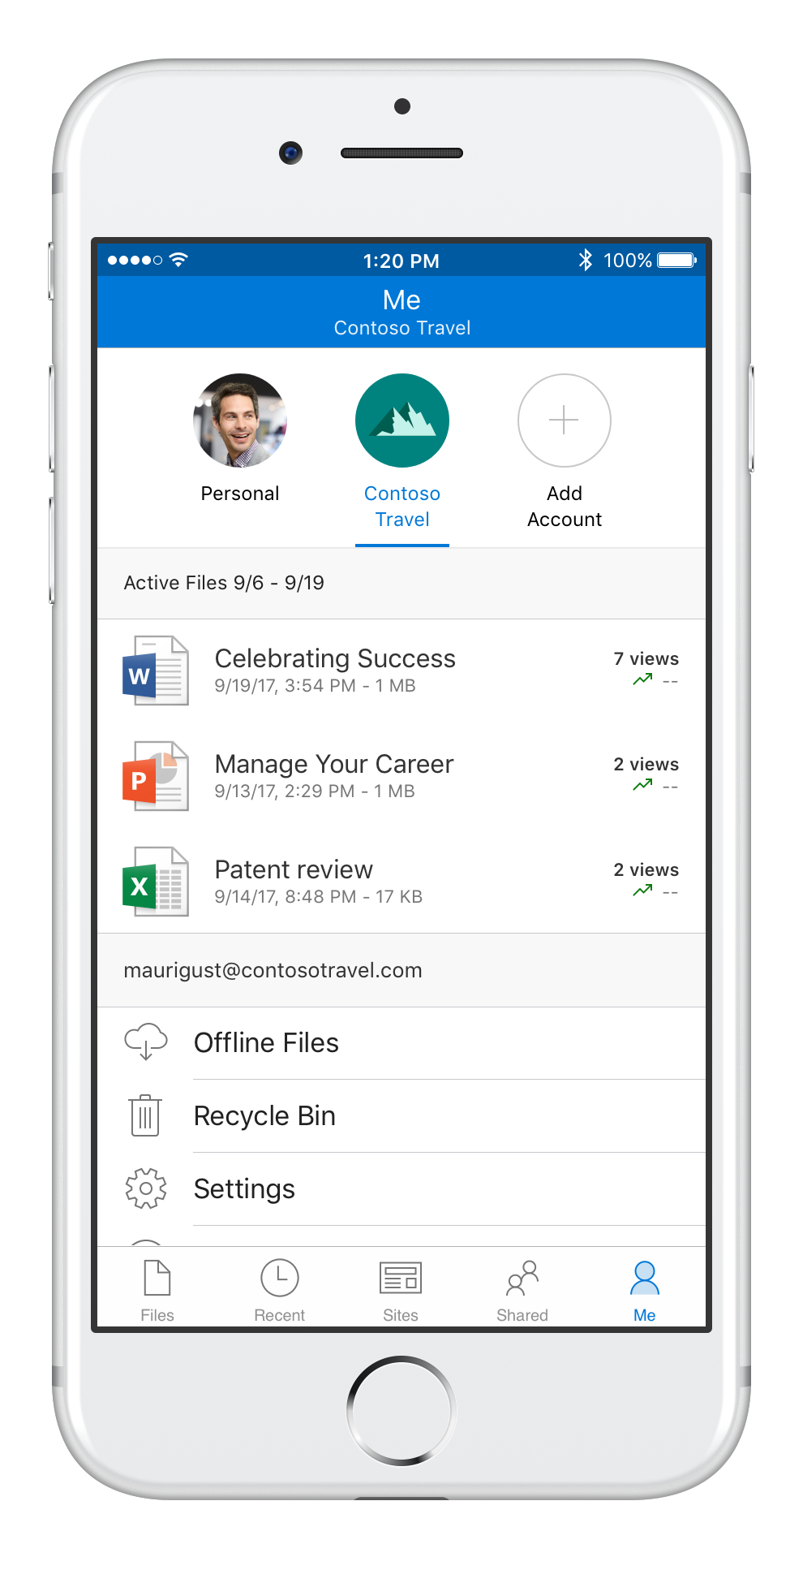
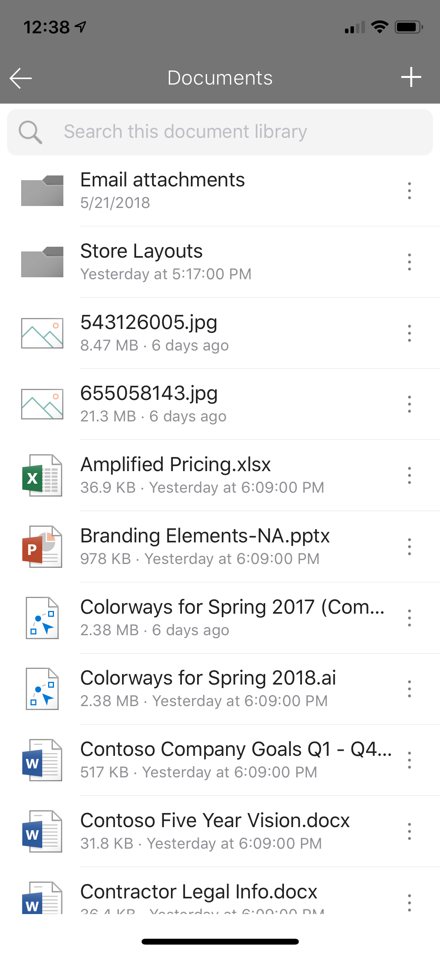
SharePoint team sites Content collaboration for teamwork
Create in seconds
Your site, your brand, your home page
Add a new Office 365 group for classic sites
Add a Microsoft Teams team
Turn on external sharing
Start with news, lists and libraries
Post a news article
Sync the document library
Build a list
Extend with PowerApps and Flow
Leverage integrated apps
Planner
Team OneNote
Shared calendar
Join a hub site
Organize and align look, feel and functionality
Use site designs to grow programmatically

Slide 13
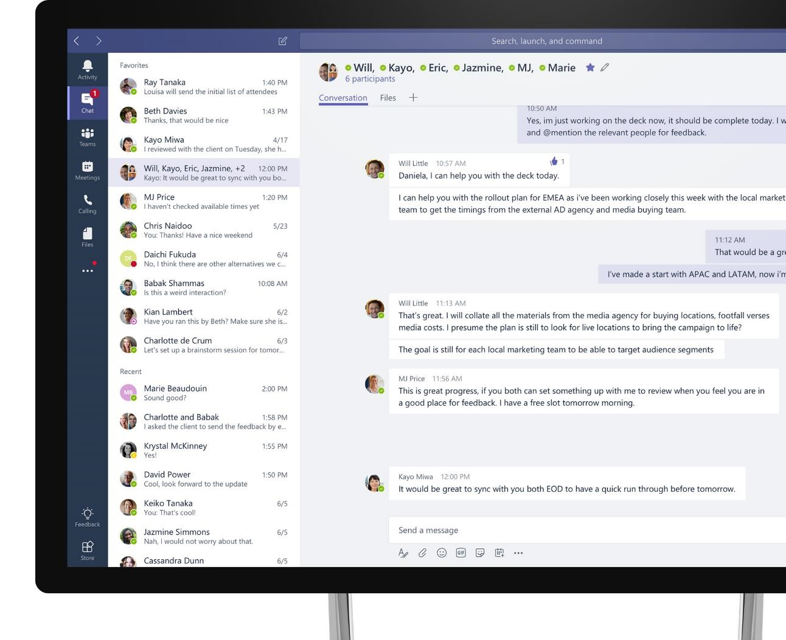
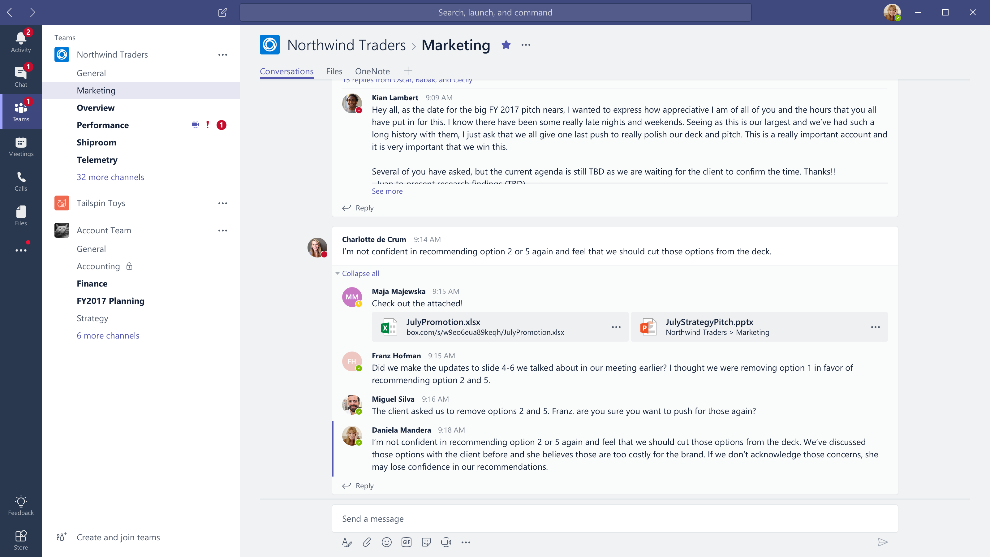








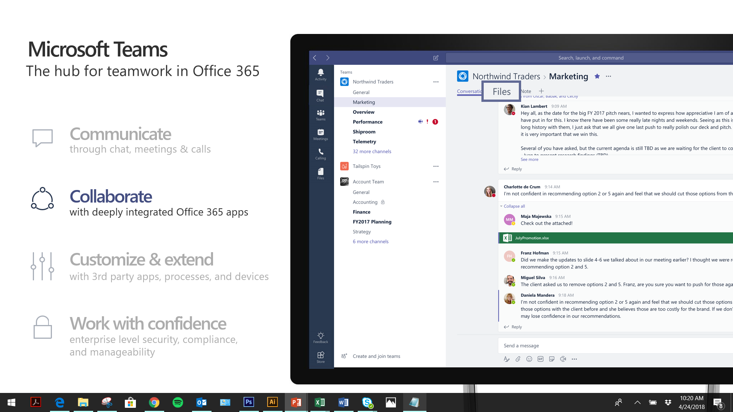



Microsoft Teams
The hub for teamwork in Office 365
Communicate
through chat, meetings & calls
Collaborate
with deeply integrated Office 365 apps
Customize & extend
with third-party apps, processes, and devices
Work with confidence
enterprise level security, compliance, and manageability
Notes:
[MAIN POINT TO LAND]
Microsoft Teams is a hub for teamwork, a chat-based workspace that enables teams to be more productive by giving them a single and secure location that brings together everything a team needs: chats, meetings, calls, files, and tools. Microsoft Teams is one place for all the needs your teams have.
Microsoft Teams delivers on four core promises to create a digital workspace for high performing teams.
[COMMUNICATE]
First, Microsoft Teams solves for the communication needs of a diverse workforce.
Since preview, Microsoft Teams has evolved to include a complete meetings experience, as well as chat, voice and video -
You can use Teams for informal 1:1 or group chats – directly on your phone if you’re on the go. Or you can have an open conversation in a channel. This enables people to share information in a transparent way to accelerate decision making. And it's super easy to move from a chat into a face to face meeting, helping you to bridge geographical barriers.
[COLLABORATE]
When it comes to collaboration, the deep Office integration enables today’s multigenerational workforce to use the Office apps they are familiar with and love - Word, Excel, PowerPoint, OneNote, SharePoint, Planner, even Power BI - right within the context of Teams. Teams is unique in how we enable collaboration.
Today, when you want somebody’s feedback, you send them the file via email, they store it locally with comments, you store it again…… it's a vicious cycle that results in v2, v3, v4 versions – and you have to jump between email and other apps to get the work done. Teams brings all the Office 365 services together – so that you can easily share and co-author files without the need for email attachments.
[CUSTOMIZE]
Many of you use other services than Office 365 as well which results in you having to jump between and spend time in disparate experiences. We built Teams to not only be the hub for Office 365 services, but for all the services and tools teams use on a day to day basis. So, you can customize Teams with tabs, connector and bots to include the apps and services you need - <mention relevant 3rd party apps like GitHub and Trello that can be included in Teams>– we have integrations with over 150 partners. For our developer community, we have also created an extensible platform, to enable building apps and to integrate with business processes.
[WORK WITH CONFIDENCE]
Microsoft Teams comes with the enterprise grade security, compliance and manageability that you expect from Office 365 which customers tell us is a huge value add for them.

Slide 14

Working as a team
Shared from the start
New members get full context
Policy and lifecycle
Office 365 Group collaboration tools
Notes:
Connect existing sites to Office 365 groups. Accelerate productivity by connecting an existing site to Office 365 groups. A group is created with a shared inbox for conversations, a shared calendar, Planner to manage tasks, and the option to connect a team in Microsoft Teams.
Deeper integration with Microsoft Teams. You can preview all 270+ file types in Teams, and you can now more easily add SharePoint pages, including your team site’s home page, as tabs in Microsoft Teams.
Read more here: "SharePoint powers teamwork in Office 365 – Ignite 2018 announcements": https://techcommunity.microsoft.com/t5/Microsoft-SharePoint-Blog/SharePoint-powers-teamwork-in-Office-365-Ignite-2018/ba-p/255465
Note:
Site themes & designs covered in comm site context

Slide 15
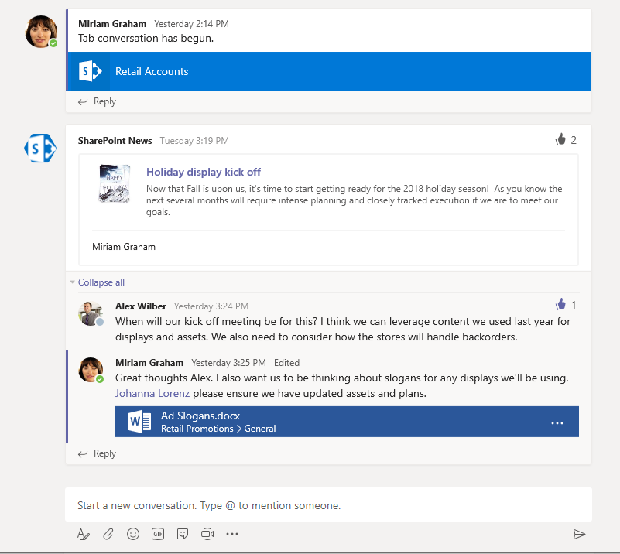
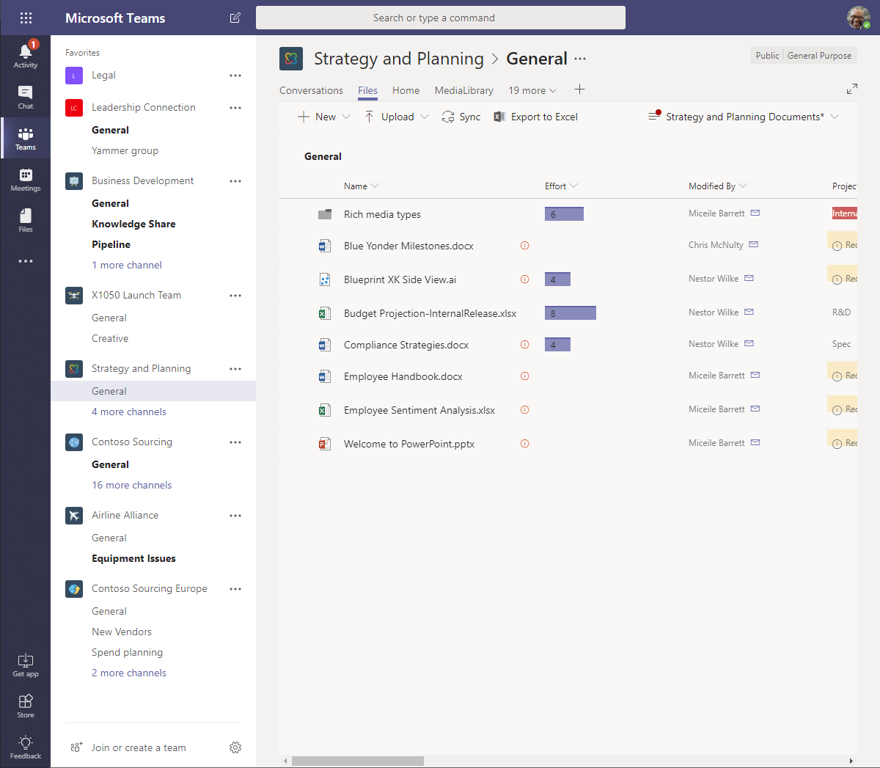
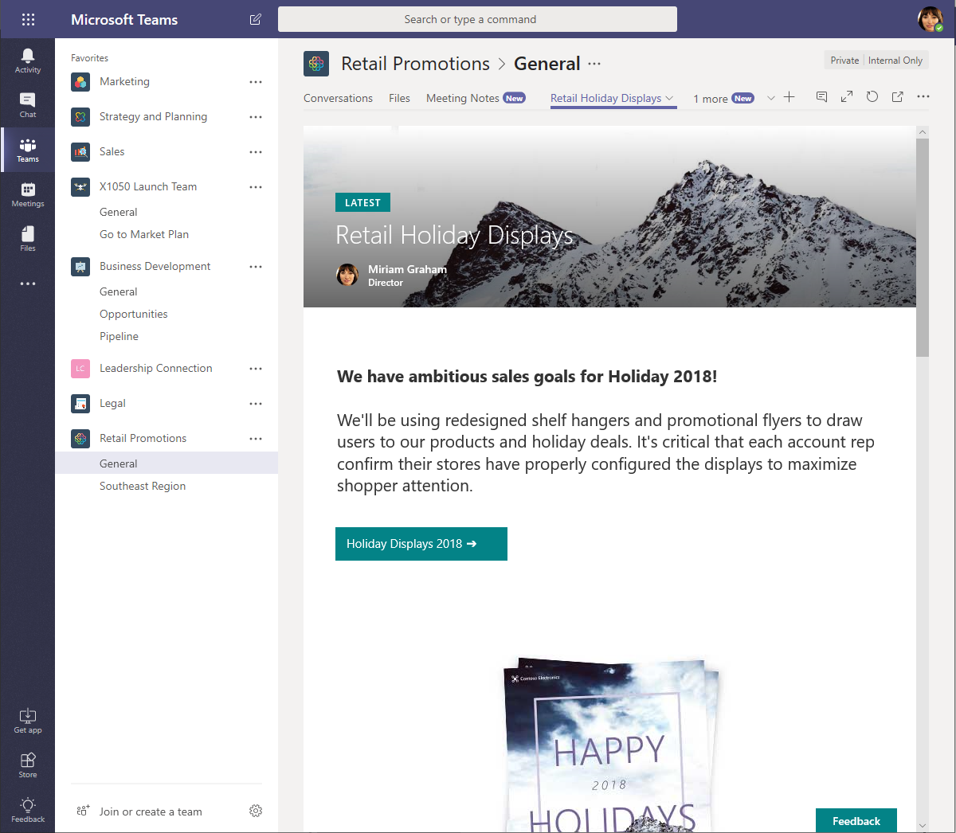
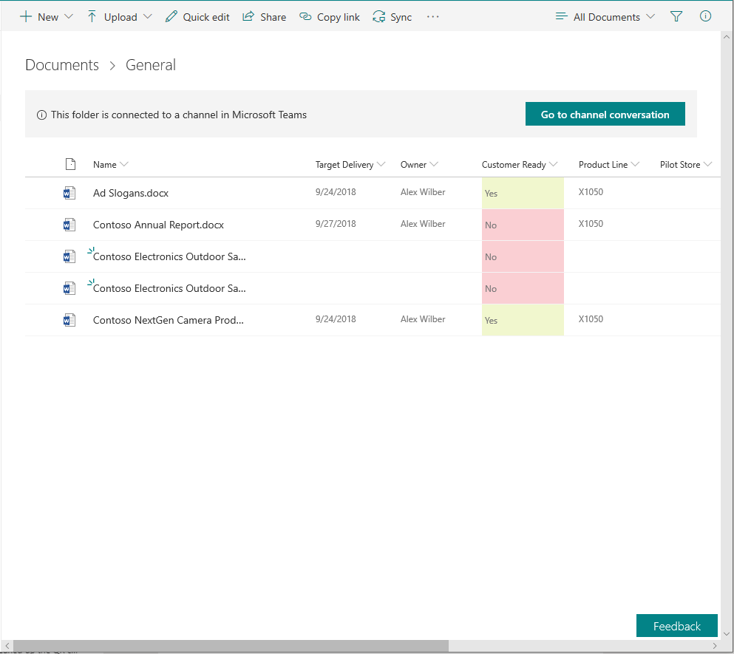
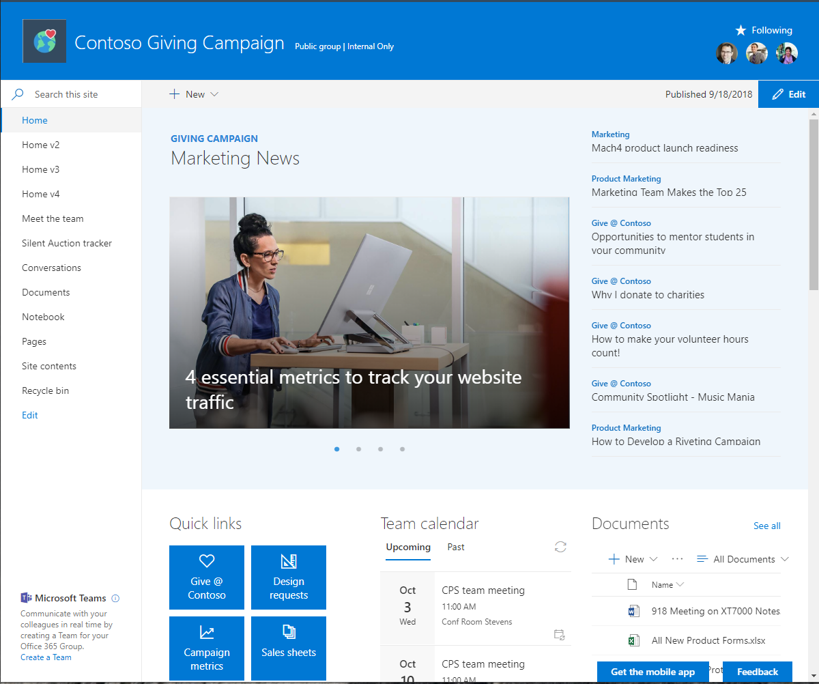
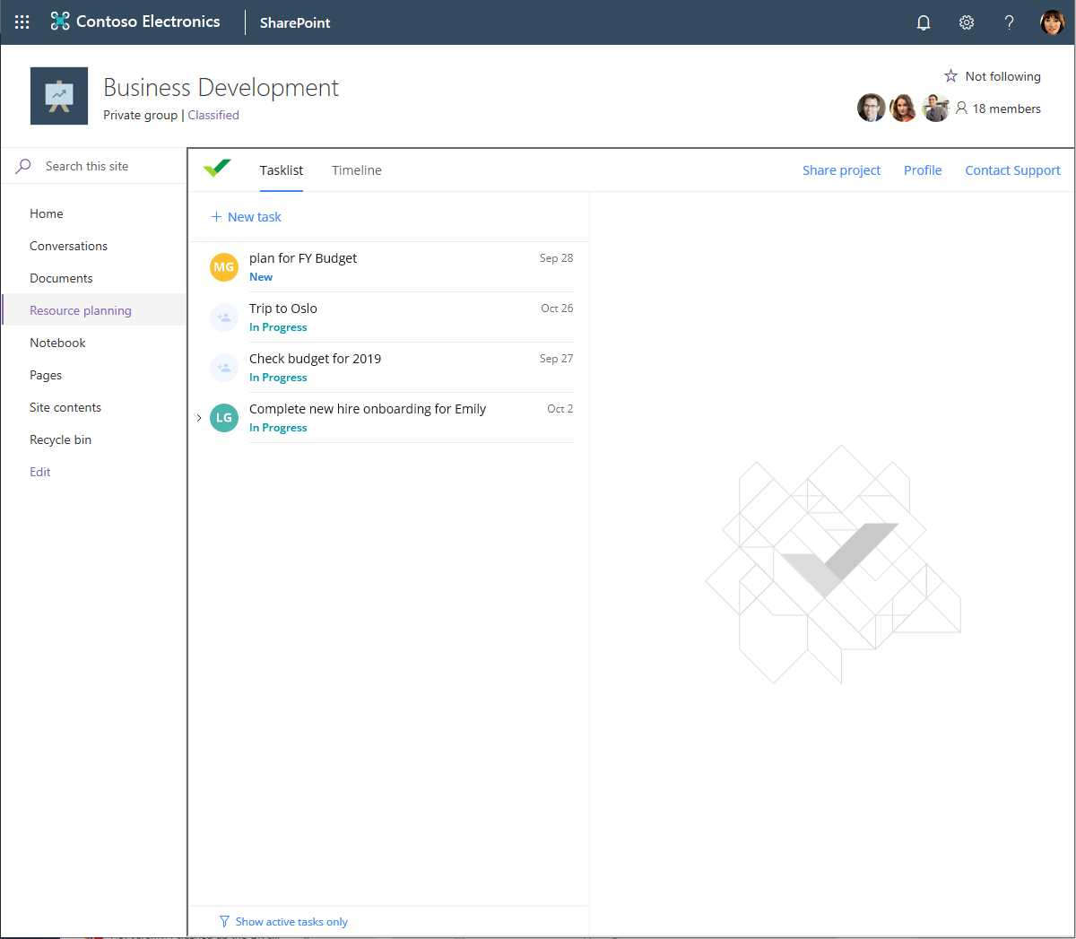
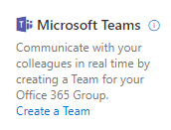
Integrated experiences
Experience SharePoint in Microsoft Teams
News
Files
Lists, pages, and apps
Experience Microsoft Teams in SharePoint
Channel folders
Add a team
Tabs as pages

Slide 16

Give the value of SharePoint + Teams
When should I use SharePoint?
Every team uses SharePoint
Where do I go to work with my team?
Wherever it’s most productive
NEW FILES EXPERIENCE Brings the full power of SharePoint libraries to teams, including sync, custom metadata & views, custom formatting, PowerApps & Flow
SHAREPOINT PAGES IN TEAMS Rich canvas to share news & information
SHAREPOINT NEWS CONNECTOR Keep your team up-to-date
SHAREPOINT LISTs as TABS in TEAMS Share data
RAPID APPLICATION DEVELOPMENT Pages with connected web parts, Flow, & PowerApps

Slide 17

Demonstration
Ignite 2019 Session
41:00 – 48:00: Teams and SharePoint Modern Workplace experiences
4:02 – 9:00: Share and Work Together on files Modern Workplace vision

Slide 18


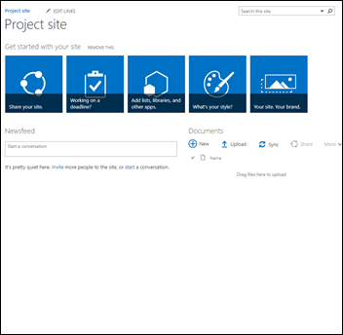
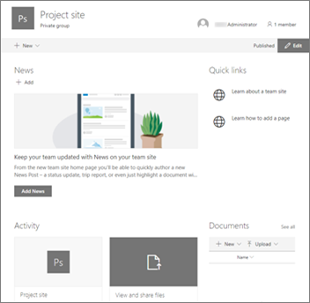
Teamwork Transformation Workshop Goal
Transition your end users’ collaboration from “classic” phase 1 engagements into phase 3 modern workplace experiences.
1
2
3
Assess SharePoint classic sites
Transform classic sites to group-connected sites
Teamify from group-connected SharePoint sites
“Classic” SharePoint user experience
Modern Workplace end user collaboration
Notes:
Talk Track:
Hopefully you are excited about these new capabilities. This engagement will be specifically to transform your identified classic SharePoint end user experiences into this new Modern Workplace experience.
It’s a 3 step process, as described in this slide.
The outcome will be to enable your end users to collaborate on their content, directly from Teams – and take advantage of all the benefits previously described.

Slide 19

Break
15 minutes
Notes:
15 minutes

Slide 20
Scenario Ideation
1 hour

Slide 21
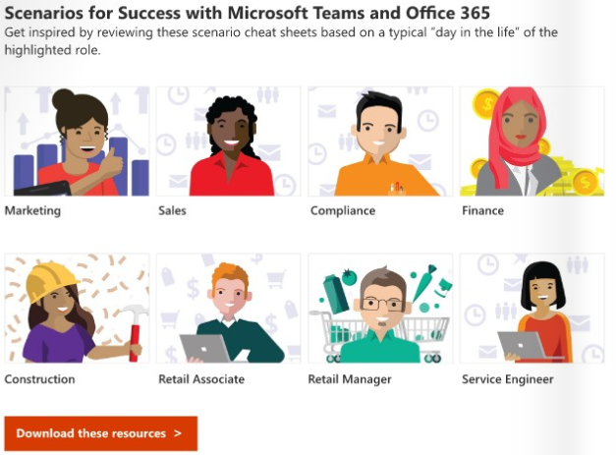
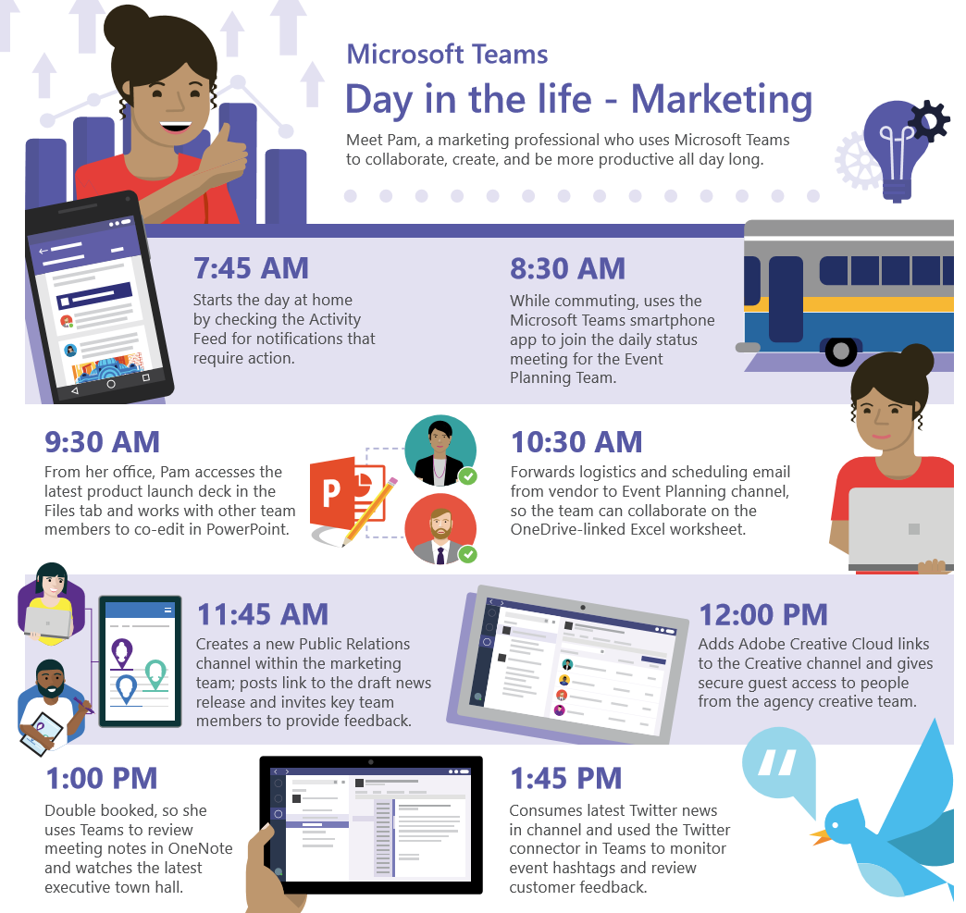
Inspiring end users with “day in the life” role-based scenarios
Activity
Draft a sample modern collaboration via Teams scenario for a given role
Goal: identified scenario replaces your classic SharePoint collaboration experience with a modern workplace equivalent
Recommend starting from the Marketing Day in the Life scenario
Microsoft Teams Adoption Guide (page 6)

Slide 22
Assessment review
60 minutes

Slide 23
Review SharePoint modernization scanner results
Exercise
Review SharePoint Site transformation candidates
Sorted in order of transformation complexity
Sites ready for transformation
Sites needing some level of remediation
Sub-Sites
Settings on the site that prevent optimal use of the modern SharePoint UI
Sites with a security setting that might be impacted by the security changes created by the Office 365 Group connect
Notes:
Review the customer’s scanner report – provided during pre-conference preparation

Slide 24
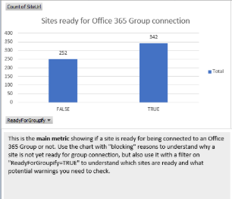
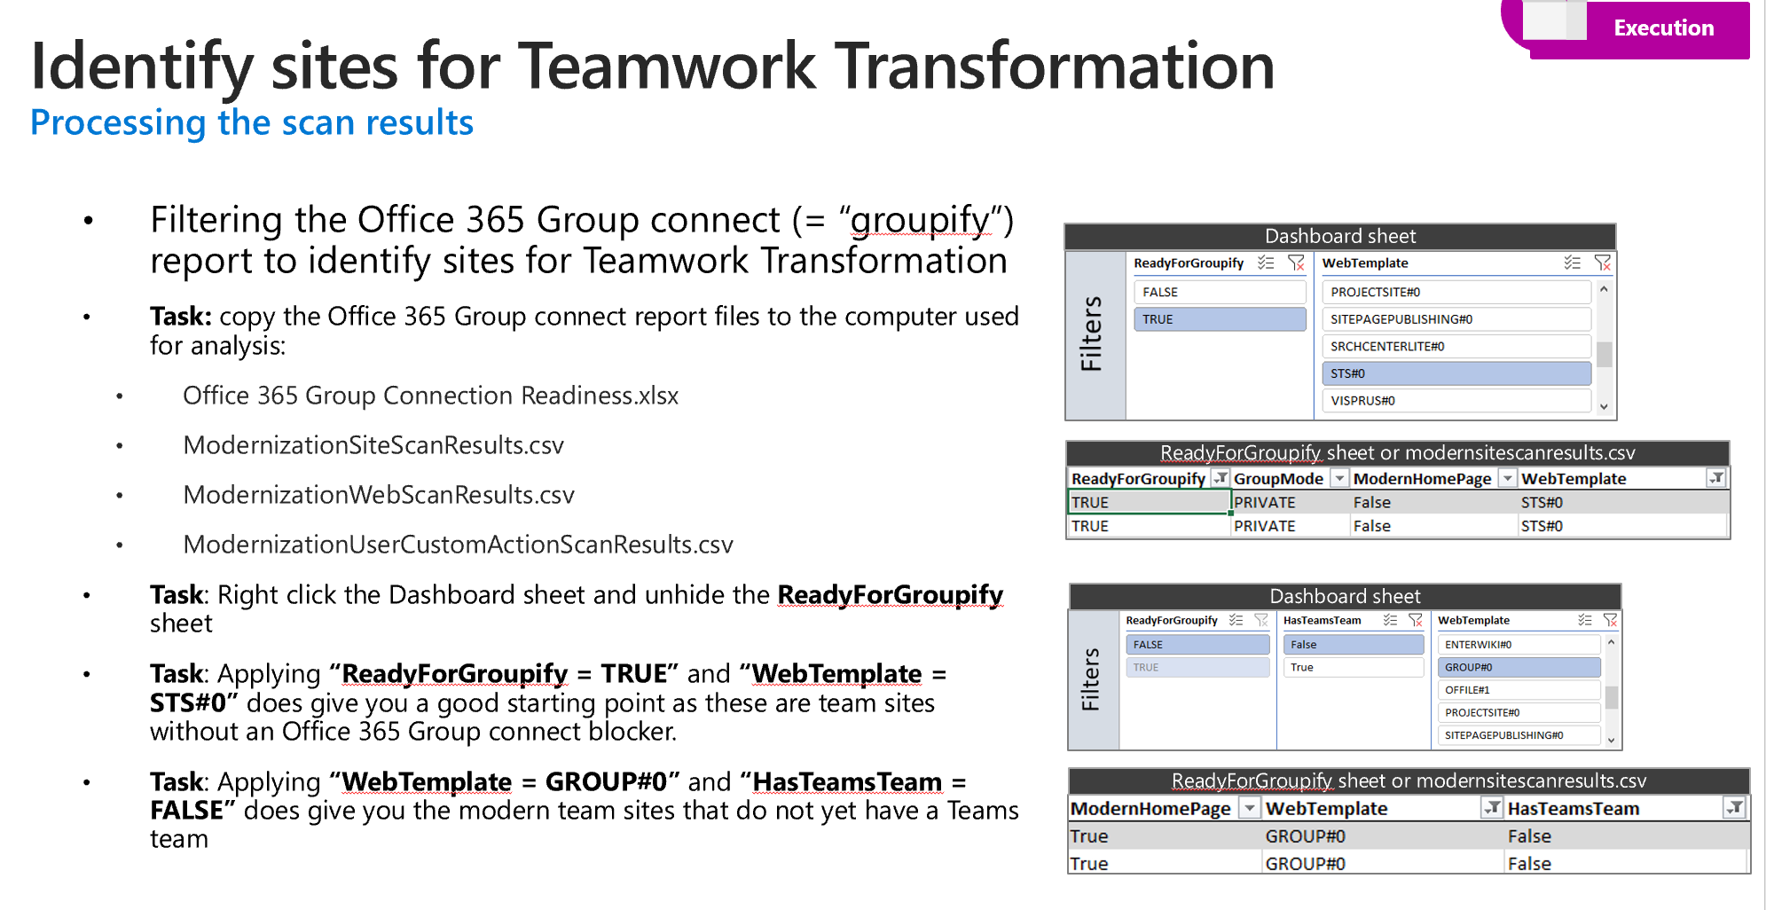
SharePoint sites ready for transformation
<Partner Prep Task>: fill in a summary based on slide 28 from the SharePoint Modernization Delivery Guide
Summary:
Total number of Sites Ready for O365 Group Connection
# of sites that meet the various criteria called out on slide 28
Unhide the ReadyForGroupify sheet and provide a view of the Sites

Slide 25
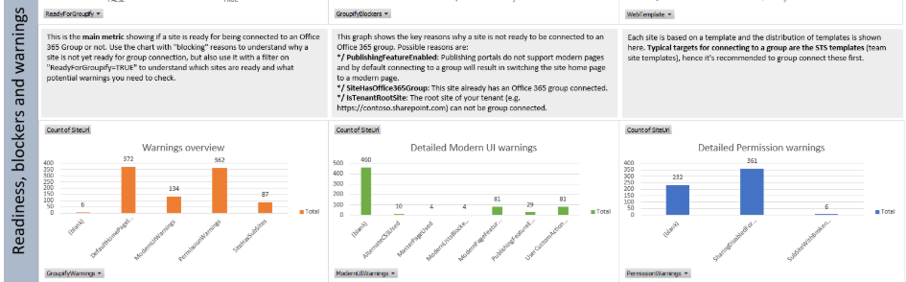
SharePoint sites requiring some level of remediation (Optional)
<Partner Prep Task>: Provide a Warnings Overview based on the Scanner results, focused on the following areas:
Sub-Sites
Settings on the site that prevent optimal use of the modern SharePoint UI
Sites with a security setting that might be impacted by the security changes created by the Office 365 Group connect

Slide 26
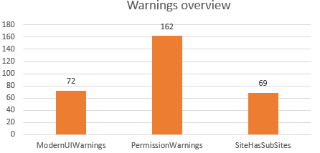
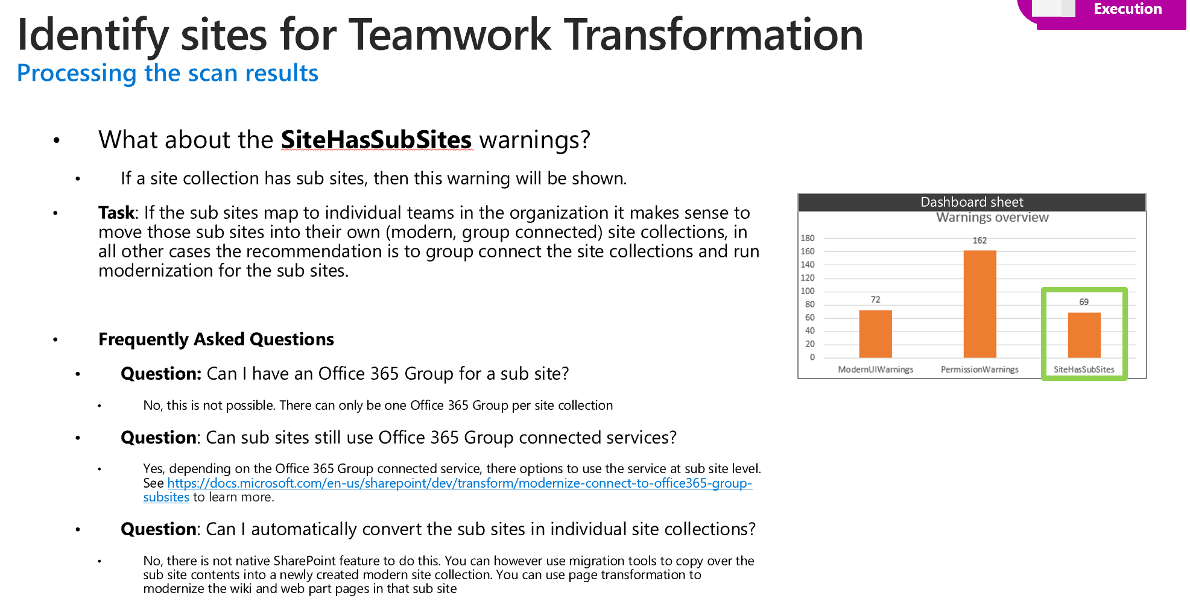
SharePoint Sub-Site Remediation (Optional)
<Partner Prep Task>: fill in a summary based on slide 29 from the SharePoint Modernization Delivery Guide
Summary:
Total number of sites matching this criteria
Review the sites affected and their associated ViewsRecentUniqueUsers value
If the customer sees ROI in conversion – follow the defined task guidance on slide 29
Dashboard sheet
Notes:
Whether this is shown or not: make a call depending on the number of sites and the associated ViewsRecentUniqueUsers values, on whether this is displayed or not.

Slide 27
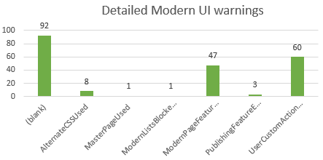
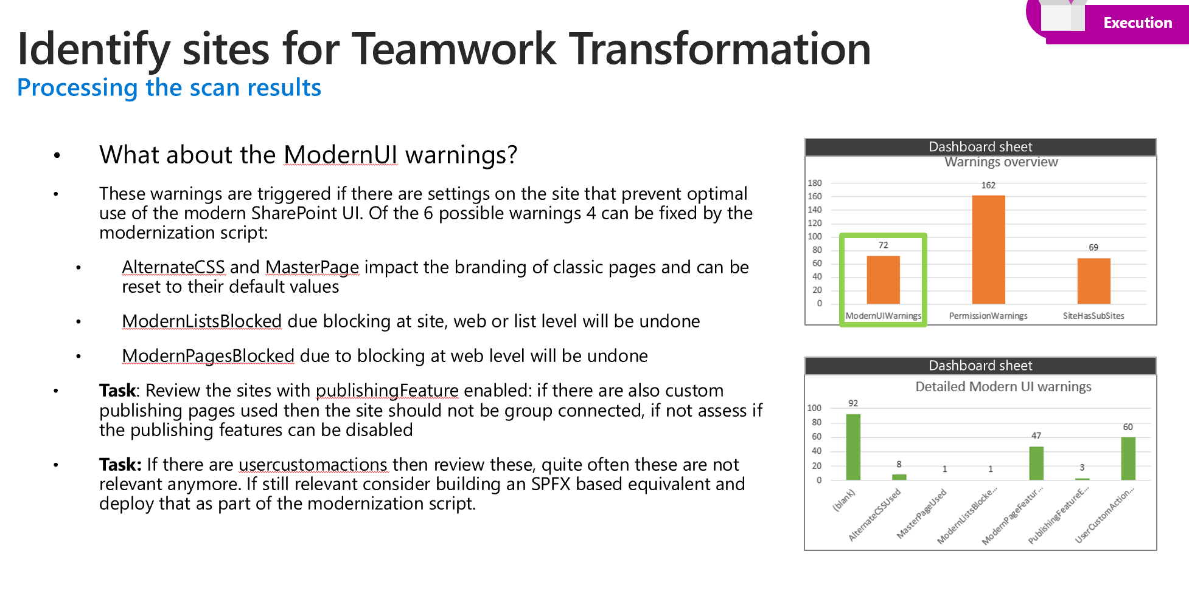
SharePoint ModernUI Remediation (Optional)
<Partner Prep Task>: fill in a summary based on slide 30 from the SharePoint Modernization Delivery Guide
Summary:
Total number of sites matching this criteria
Review the sites affected and their associated ViewsRecentUniqueUsers value
If the customer sees ROI in conversion – follow the defined task guidance on slide 30
Dashboard sheet
Dashboard sheet
Notes:
Whether this is shown or not: make a call depending on the number of sites and the associated ViewsRecentUniqueUsers values, on whether this is displayed or not.

Slide 28
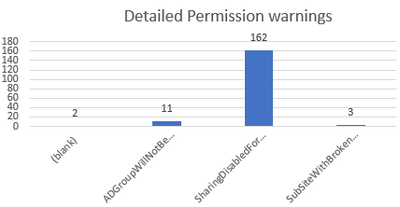
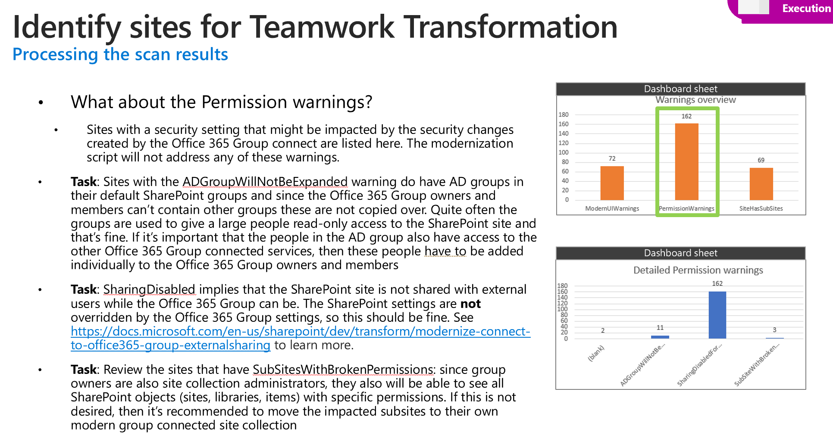
SharePoint Permissions Remediation (Optional)
<Partner Prep Task>: fill in a summary based on slide 31 from the SharePoint Modernization Delivery Guide
Summary:
Total number of sites matching this criteria
Review the sites affected and their associated ViewsRecentUniqueUsers value
If the customer sees ROI in conversion – follow the defined task guidance on slide 31
Dashboard sheet
Dashboard sheet
Notes:
Whether this is shown or not: make a call depending on the number of sites and the associated ViewsRecentUniqueUsers values, on whether this is displayed or not.

Slide 29

Lunch
60 minutes
Notes:
(Use lunch as an overflow if needs be. During the lunch break, all MS people need to be asking pointed questions (recon!) of the attendees, uncover nuggets, and report back to the presenter on what they’ve found before we reconvene.)

Slide 30

Site Transformation approach
60 minutes

Slide 31
Approach: build Teamwork Transformation waves Group the selected site collections in transformation waves
The actual transformation work will be done in waves
A waved approach allows you to start small followed by gathering feedback and if needed adjusting the approach for the next wave. After each transformation wave this feedback and adjustment step will be taken
Split the list of site collections we’ve gathered into waves:
A pilot wave: these are small waves, typically with sites from IT savvy users or from the folks in the organization that possess a willingness to embrace change
The following “production” waves can be organized in various ways: by department, by country, by complexity, …
Pilot 1
Feedback
Wave 1
Feedback
Wave 2
Feedback
Wave n

Slide 32
Pilot wave prioritization exercise: impact vs ease of implementation
High
Med
Low
(Copy these to map!)
Medium priority | High priority
Low priority | Low priority
Site1 name
Site2 name
Willingness to embrace change
Site3 name
Site4 name
Site5 name
Site6 name
Site7 name
Add top pilot site candidates as needed
Hard
Somewhat
Easy
Ease of implementation
Notes:
Choose a site for Pilot Prioritization
Facilitator: use this template to get started.
Goal: Identify and agree upon which Pilot site you are going to focus on.
Steer audience towards choosing a site that rate highly across the following criteria:
Willingness to Embrace Change
typically with sites from IT savvy users or from the folks in the organization that possess a willingness to embrace change
Has organizational value – but isn’t “High Priority” or mission critical. The key is that the site chosen will be used by a representative set of users – that will provide valuable feedback.
Likely to obtain site owner buy-in.
Is collaborative. Sites that allow employees to interact and collaborate demonstrate the real value of Teams.
Ease of Implementation
Is obtainable – should be straight forward to run transformation tech on, ideally falling into Slide 24 Ready to Transform criteria
This will be your prioritized list on sites to pitch to site owners – to obtain pilot agreement.
Those site owners need to become your advocates and allies.

Slide 33
Additional Key Considerations
30 minutes

Slide 34
Office 365 Group naming strategy How will you name the Office 365 Groups?
The Office 365 Group names you’ll be using during the Office 365 Group Connect step will have to be unique across your Azure AD environment. Therefore it’s important that you think about a group naming convention.
Task: Define a group naming convention that you can apply to the sites that will be modernized
Task: Consider configuring Office 365 Group naming policies in Azure AD to help enforce group naming. See https://docs.microsoft.com/en-ca/azure/active-directory/users-groups-roles/groups-naming-policy and https://docs.microsoft.com/en-us/office365/admin/create-groups/groups-naming-policy?redirectSourcePath=%252fen-us%252farticle%252foffice-365-groups-naming-policy-6ceca4d3-cad1-4532-9f0f-d469dfbbb552&view=o365-worldwide to learn more.
Notes:
Frequently Asked Questions
Question: How can verify that the groups I propose are valid?
Group name (=alias) verification is part of the modernization scripts, which will be covered in the Execution portion of this engagement

Slide 35
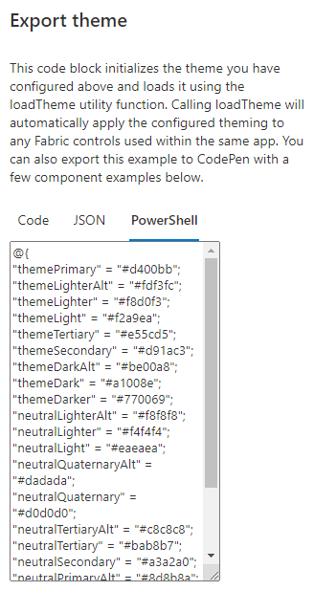
Office 365 Tenant themes How to setup tenant themes?
During the Teamwork Transformation you’ll be (optionally) setting the site’s theme to a tenant theme. For this to work you’ll need to first ensure the needed tenant themes are available
Task: Create the needed tenant themes. Use the online theme generator (https://aka.ms/themedesigner) to create the themes, use the Export theme option and copy the PowerShell formatting
Task: Add the new theme to the tenant via
Assigning the copied PowerShell to a variable: $ContosoTheme = @{“themePrimary”=…
Adding the theme: Add-PnPTenantTheme -Palette $ContosoTheme -Identity “Contoso Corporate theme" -IsInverted:$false
See https://docs.microsoft.com/en-us/powershell/module/sharepoint-pnp/add-pnptenanttheme?view=sharepoint-ps for more details
Notes:
Frequently Asked Questions
Question: How can I get a list of available tenant themes using PnP PowerShell?
You can use the Get-PnPTenantTheme cmdlet to get a list of available tenant themes

Slide 36


Welcome back
Microsoft Teamwork Transformation workshop

Slide 37
Day 2 key outcomes
Create wave transformation plan
Create wave roadmap
Create end user adoption readiness plan

Slide 38
Day 2 agenda
9:00 – 10:00 |  | Wave transformation planning
10:00 – 11:00 |  | Wave transformation roadmap
11:00 – 12:00 |  | Lunch break
12:00 – 2:00 |  | Adoption Planning
2:00 – 2:30 |  | Recap, Next Steps

Slide 39

Wave Transformation Plan
60 minutes

Slide 40
Finalize a Wave Transformation Plan
Partner Prep Exercise: Analyze remaining sites to look for equivalency classes across:
department, country, transformation complexity…
Group the sites – and re-examine ROI based on unique users
Review initial results review with the customer – to solicit feedback

Slide 41
Activity: wave transformation roadmap
60 minutes

Slide 42
Exercise: Wave transformation roadmap
Add your waves to the proposed timeline in intended order
Pilot
Wave2
Wave3
Wave4
Wave5…
Wave1
Date
Date
Date
Date
Date
Date
Notes:
Map out proposed waves on a timeline

Slide 43
Lunch
60 minutes
Notes:
(make sure strategy and development are able to sync up at this time, PM should get up to speed on what’s happening in both groups so they can give an update.)

Slide 44
Activity: Adoption Planning
120 minutes

Slide 45
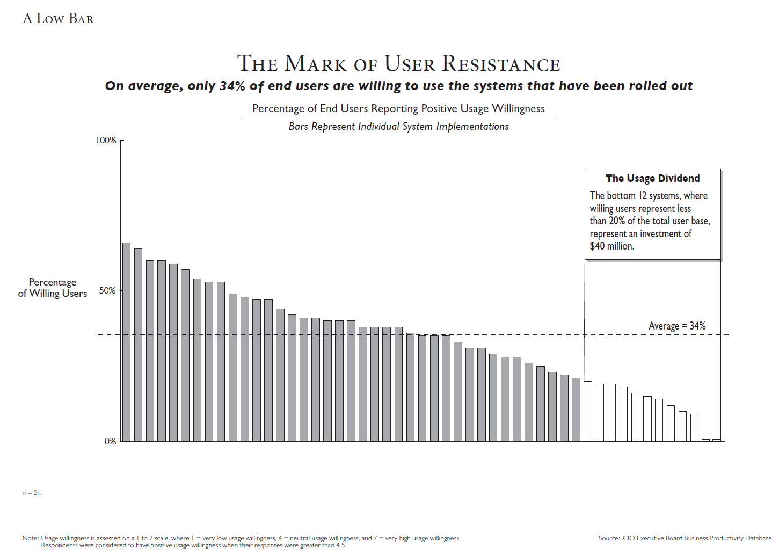
READY, SET,…?
Notes:
Internal Note: If customer understands the importance of adoption, this slide can be skipped
It’s human nature for us to be resistant to change
It’s no different with technology
The CIO Executive Board found in a survey they conducted that ONLY 34% of end users are willing to use new systems that have been rolled out by their organization
This is not SP specific, it’s a reality when rolling out any technology
When it comes to rolling out new technology we cannot ignore the people side of the change.

Slide 46




Adoption Success Factors
LEARN AND REINFORCE
Stakeholders
Recruit executive sponsors
Empower champions
Scenarios
Prioritize SharePoint scenarios
Measure success
Awareness
Implement comms campaign
Execute launch events
Training
Train end users
Ready help desk
Notes:
When it comes to rolling out new technology, we cannot ignore the people side of the change.
Learning from our engagements with thousands of customers and research, we have identified the most important success factors for driving end user adoption to be:
Identifying and recruiting key stakeholders from across the business
Identifying and prioritizing scenarios
Generating awareness and excitement with an internal communication campaign
Readying end users for the new technology through training
Support BoM for each of these elements, high-level review with customer

Slide 47
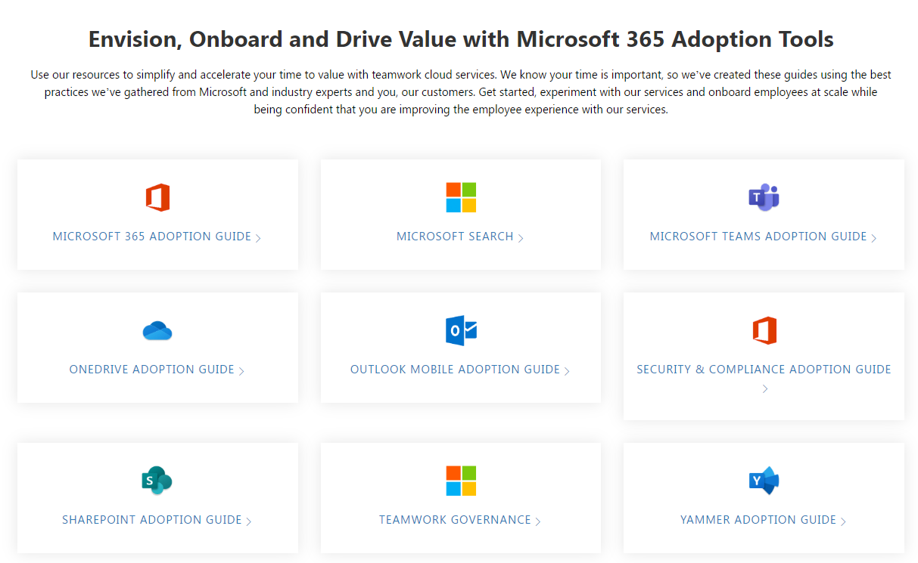
Resources across all the Success Factors
Use available templates at https://resources.techcommunity.microsoft.com/adoption/

Slide 48
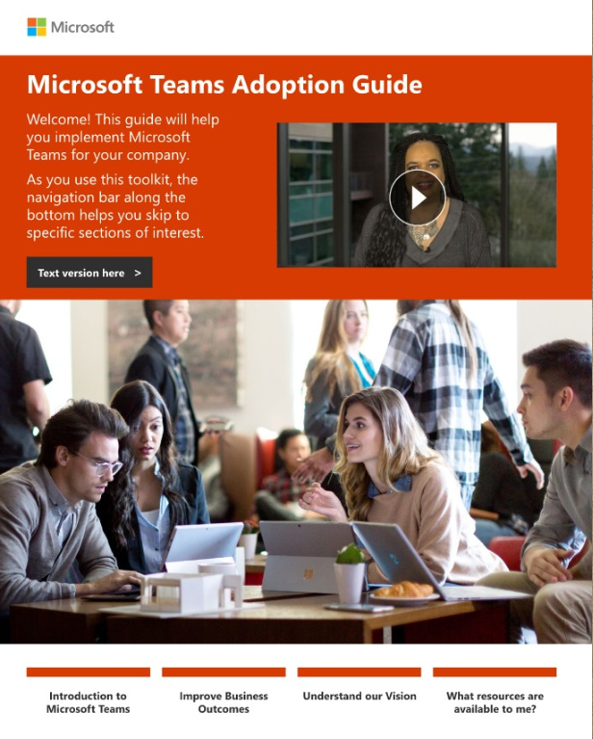
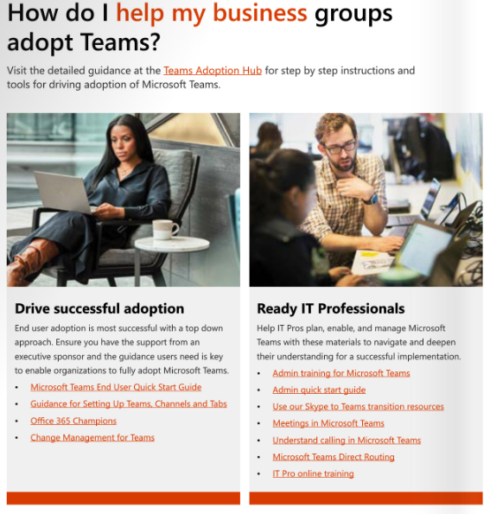
Specific Teams Assets
Teams Adoption Guide: https://aka.ms/TeamsToolkit

Slide 49
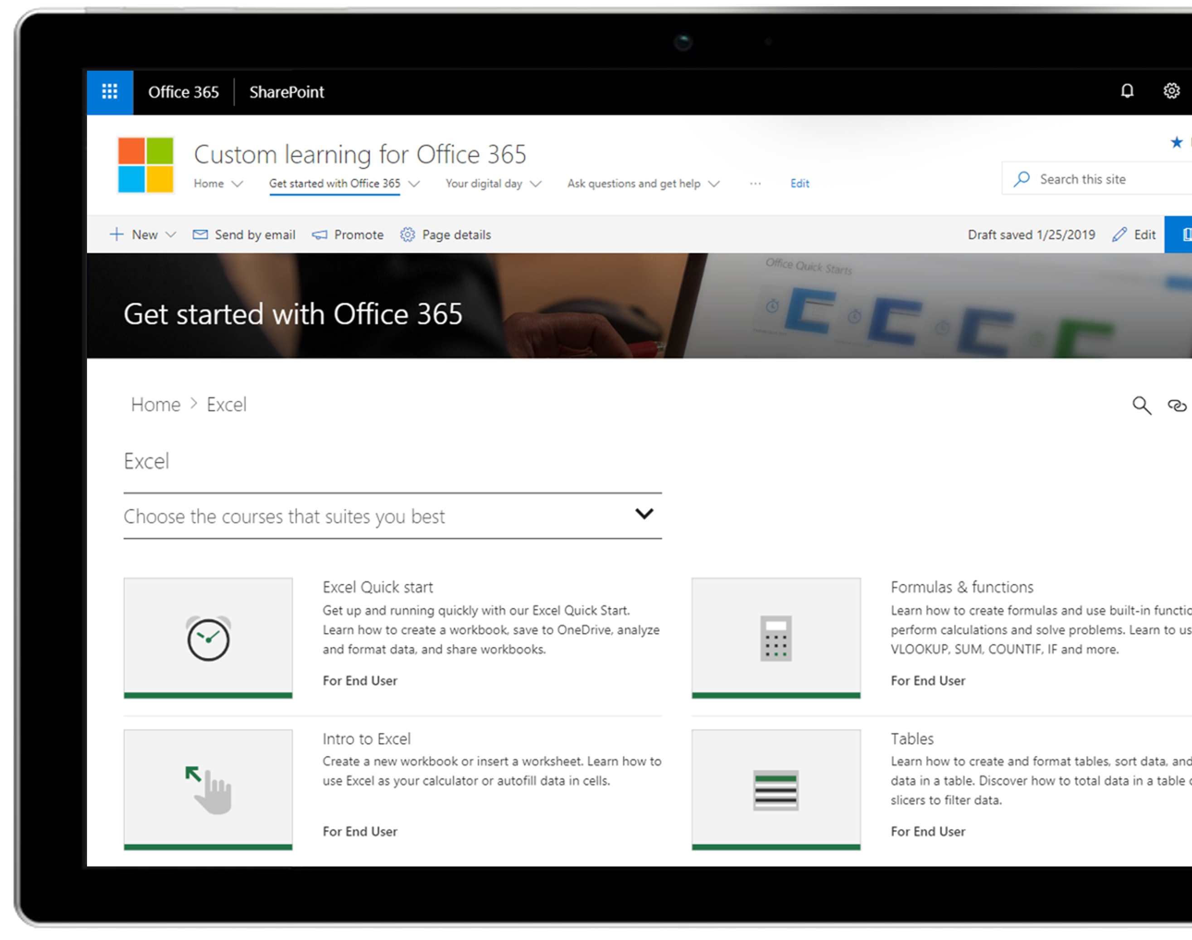
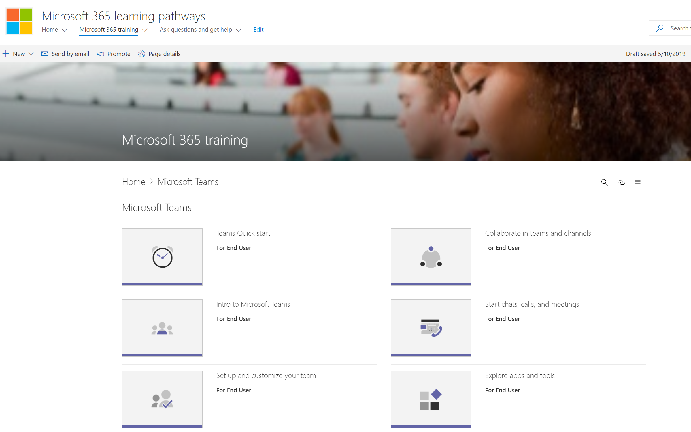
Train users on how to use Teams
Use Microsoft 365 learning pathways to train end users on how to use Microsoft 365 learning pathways and create SharePoint sites
Microsoft 365 learning pathways is an on-demand training solution designed to increase knowledge, usage and adoption of Office 365 in an organization.
https://aka.ms/M365LP
Notes:
Quick
As we discussed earlier, M365LP is…
Train users on how to create intranet sites

Slide 50
Exercise: Develop your plan
Exercise: formalize adoption plan leveraging the afore-mentioned assets, aligned to discussed Success Factors
Stakeholders
Document identified Business Decision Makers who will be key influencers
Identify Champions and formalize their engagement program
Identify customer change management resources who will execute on the program
Scenarios
Leverage the scenario ideation performed on day1
Discuss additional scenarios as necessary
Awareness
Leverage the assets in the TeamsToolkit, identifying specific assets that will be used
Training
Determine which specific Training assets to leverage
Identify their delivery mechanism (Learning Pathways, etc)

Slide 51
Exercise: Build Adoption Plan per wave
Identify Stakeholders to lead communications
Develop end user communication strategy and training plan
Develop adoption related assets (Teams announcement, posters, training materials, etc.)
Wave Launch
Execute end user communications strategy and training plan
Notes:
Note to Facilitator – Customize per customer’s input and in consideration of scenario. Add timelines and assign responsibilities to the team

Slide 52
Next steps
30 minutes

Slide 53
Open issues and resolution plan
ISSUE | RESOLUTION PLAN | Owner
Capture issues here… | Capture resolutions here

Slide 54
Next steps and actions
NEXT STEP | DATE | DESCRIPTION | OWNER
Accountability & timeline assignment |  | Ensure accountability and timeline is assigned for closing out any existing issues.
Roadmap socialization |  | Plan socialization of the roadmap with appropriate stakeholders. This will help get resources commitment to bring the roadmap plan to reality.
Pilot |  | Pilot prototype with select group of end users.
Finalize rollout plan |  | Take findings from Pilot and build a final wave plan for full launch.

Slide 55
Thank you

Slide 56
Appendix –
OneDrive, SharePoint, Teams relationship

Slide 57

Share and work together on files throughout Microsoft 365
Intelligent file experiences
OneDrive
Teams
SharePoint
Work with all your files
Work with your team
Work across your organization
Anywhere access to all your files
Find, view, share, edit and organize files
Scan documents, receipts and whiteboards
Sync files to PC & Mac and work offline
The hub for teamwork
Create, view, edit and discuss team files
Collaborate with integrated Office apps
Integrate calls, meetings, and applications
The intelligent intranet
Publish to a broad audience
Capture and manage content and records
Create sites, news, lists and apps
Intelligent content services
Notes:
Microsoft 365 empowers individuals, teams, and organizations to share and work together with files
Let’s look at how three of Microsoft’s best-of-class applications are optimized for file collaboration scenarios, while sharing intelligent file experiences, content management, security & compliance

Slide 58
Share and work together on files throughout Microsoft 365
OneDrive
Work with all your files
Create, view & edit files on any device
Organize and share your files
Scan documents, receipts and whiteboards
Sync files to PC & Mac and work offline
Intelligent file experiences
Intelligent content services
SharePoint
Teams
Work across your organization
Work with your team
Notes:
OneDrive is where you can work with all your files—your individual work files and the files shared with you across Microsoft 365—on any device.

Slide 59
Share and work together on files throughout Microsoft 365
Teams
Work with your team
Collaborate with integrated Office apps
Chat, calls and meetings
Create, view and edit team files
Customizable hub for teamwork
Intelligent file experiences
Intelligent content services
OneDrive
SharePoint
Work with all your files
Work across your organization
Notes:
Teams is a hub for teamwork where you and your team can collaborate on files, communicate, and streamline processes.

Slide 60
Share and work together on files throughout Microsoft 365
SharePoint
Work across your organization
Share files with a broad audience
Intranet sites, news, lists and apps
Capture and distribute knowledge
Intelligent content management
Intelligent file experiences
Intelligent content services
Teams
OneDrive
Work with your team
Work with all your files
Notes:
SharePoint is the intelligent intranet with sites that let you communicate broadly and manage content across the organization.

Slide 61
Share and work together on files throughout Microsoft 365
OneDrive
Work with all your files
Intelligent file experiences
Intelligent content services
View 320+ file types
AI-powered content processing
Share and collaborate in real-time
Access controls and DLP
Find files that matter to you
Records and retention management
Streamline processes
MIP and intelligent encryption
SharePoint
Teams
Work across your organization
Work with your team
Notes:
You can work seamlessly across applications and devices with coherent and powerful files experiences, turbocharged by AI. And you can work confidently, knowing that your files are protected with industry-leading security and compliance

Slide 62
Appendix –
Customer Stories

Slide 63




Having all our files and conversations in one place is highly valuable, especially for our high-level executives, who like the ability to do a quick search and find the content they need without having to leave the app they’re in.
Jason Remaley
Director, Product Planning, Cox Automotive
LEARN MORE
Notes:
Cox Automotive streamlines collaboration across 25 brands with Microsoft OneDrive and Teams
With 25 brands across five continents dedicated to the exchange of vehicles, Cox Automotive is one of the largest names in the automotive industry worldwide. As the company has acquired new brands, it has grown rapidly. But, with each brand came a new set of collaboration and productivity tools—and with that came extreme complexity.
The company needed to get everyone on the same page. By rolling Microsoft OneDrive and Microsoft Teams out across the international organization, it put the same tools in everybody’s hands—enabling easier information sharing and seamless collaboration across the business.
Read the case study here.
https://customers.microsoft.com/en-us/story/cox-automotive-automotive-onedrive

